Slide 1
Computational Astrobiology Hackathon
Marco immanuel rivera

Slide 2
Outline
Tutorial 2
Tutorial Naïve Bayes
Tutorial 3
Tutorial 4
Tutorial PCA
Tutorial 5

Slide 3
Tutorial 2: Technosignatures
Forked and cloned Gemma Danks’ GitHub repo to my personal GitHub
To summarize her work:
To understand Cocconi and Morrison’s seminal paper (1959) on detecting signals of extraterrestrial origins (which launched SETI)
This signal must have a minimum frequency that is dependent on the distance to the star and the diameter of the mirror of our detector.
Prof Danks’ goal is to understand how this minimum frequency was derived: by equating spectral irradiances from the host star (has f^2 dependence from Rayleigh-Jeans) and galactic background (has 1/f dependence)
What she want to investigate is how the type of star (classified by its own radius and temperature) contributes to this minimum frequency.

Slide 4
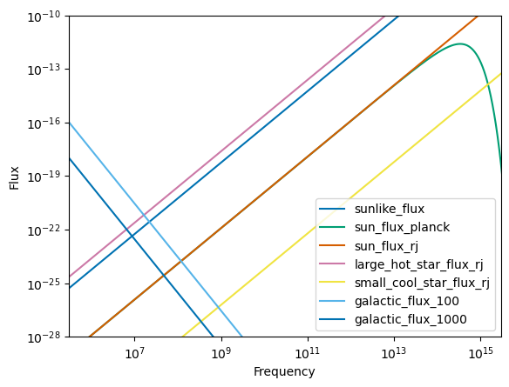
Figure: flux vs frequency for several kinds of stars and the galactic fluxes received by two detectors
Intersections between the galactic and star fluxes give the minimum frequency!

Slide 5
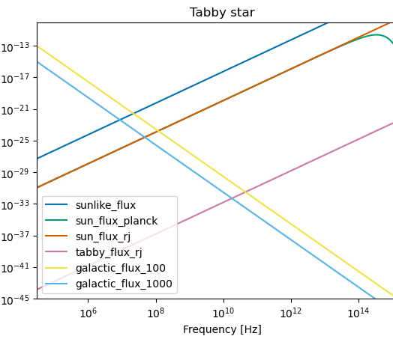
Figure: Tabby’s star flux compared to sun’s flux and galactic flux
Distance to star: 1447 ly
Stellar temp: 6750 K
Stellar radius: 1.58 solar radii
Intersections between the galactic and star fluxes give the minimum frequency!

Slide 6
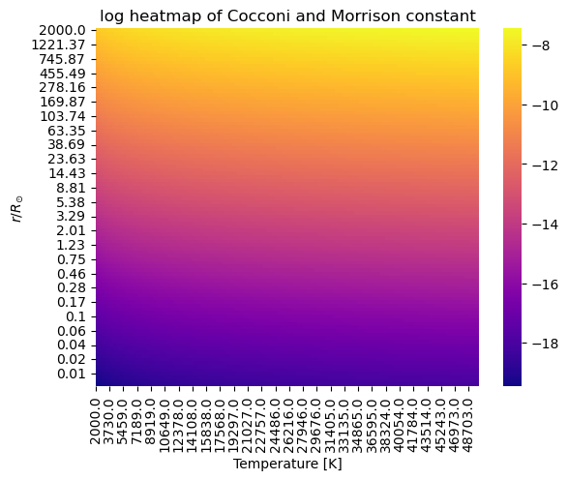


Figure: Cocconi and Morrison’s coefficient k for the spectral irradiance of the host star
Has a dependence on the radius and temperature of the star such that

Slide 7
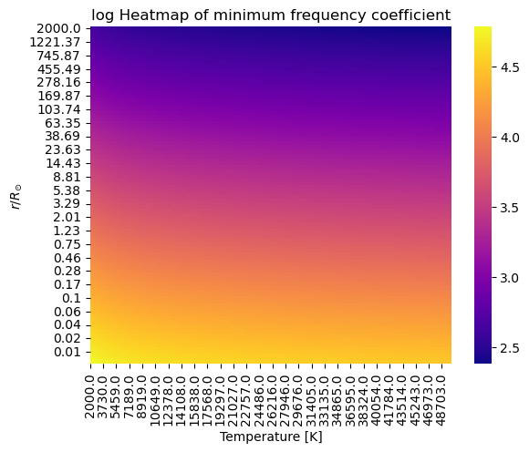


Figure: Minimum frequency coefficient f0
Carries the dependence of the Cocconi and Morrison constant k

Slide 8
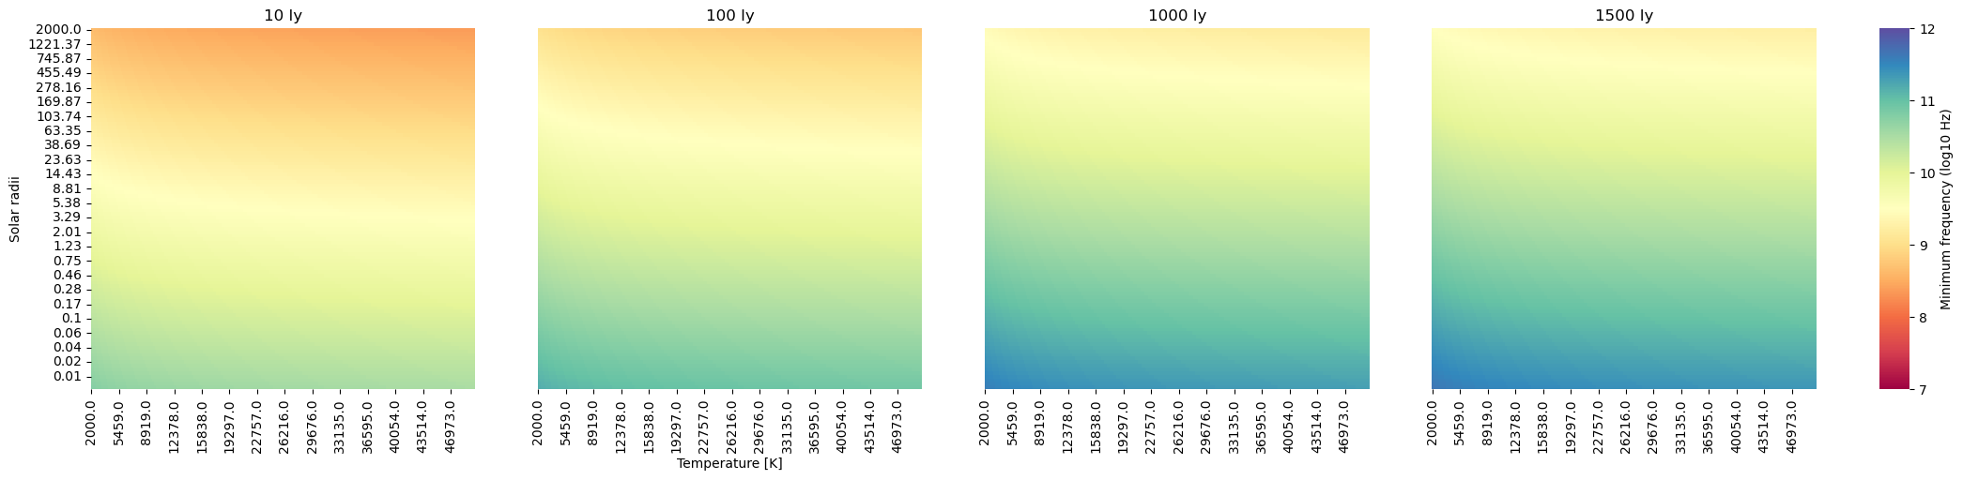
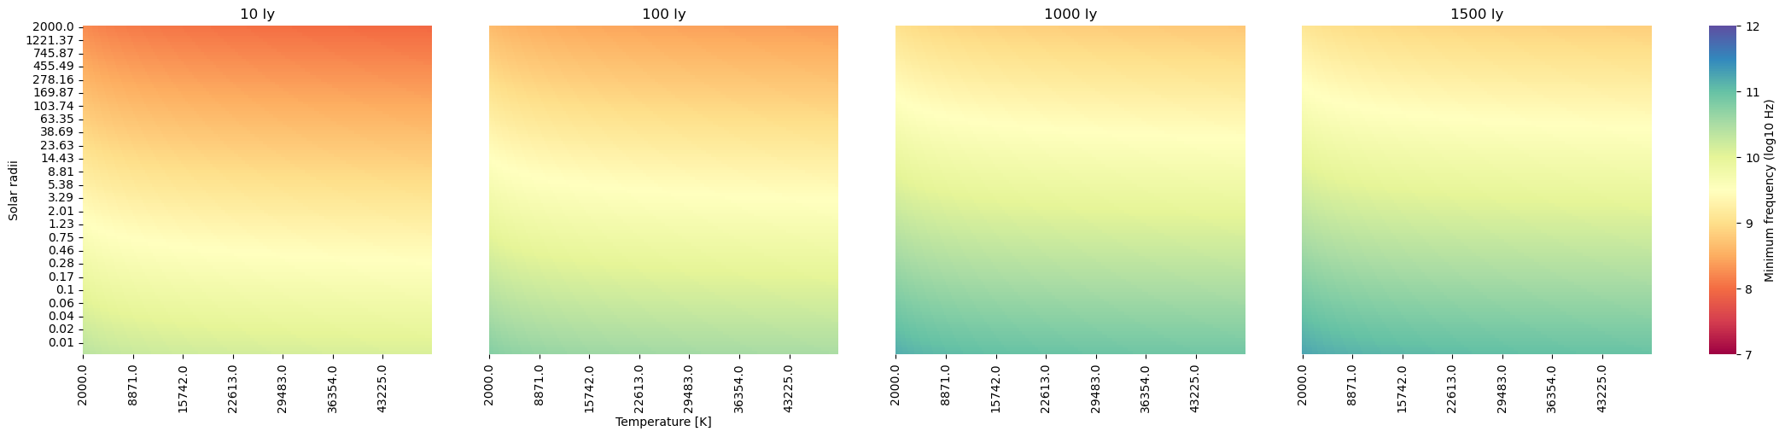
Varying the distances given a 10000 m^2 Detector
Varying the distances given a 1 km^2 detector

Slide 9
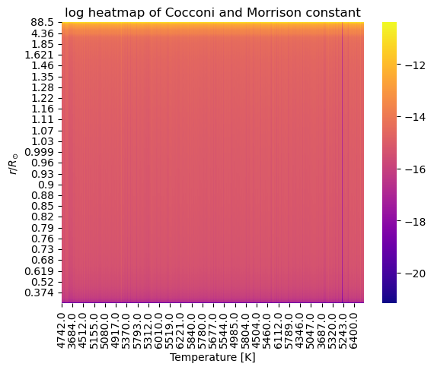
Innovation: Cocconi and Morrison’s coefficient k for the spectral irradiance of host stars of exoplanets (from exoplanet.eu/catalog)
Has a dependence on the radius and temperature of the star such that

Slide 10
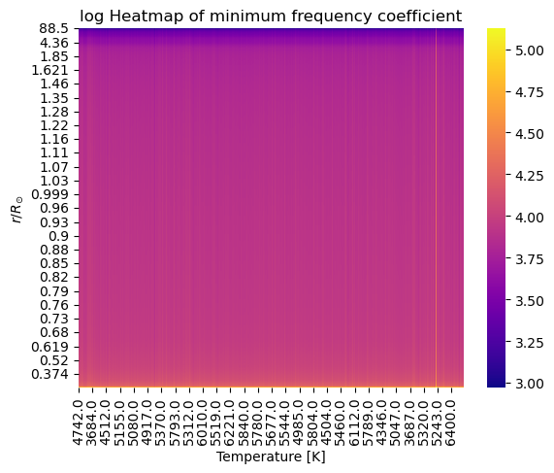
Innovation: Minimum frequency coefficient f0
Carries the dependence of the Cocconi and Morrison constant k

Slide 11
Tutorial Naïve Bayes
Made a copy of Jake Vanderplas’s Naïve Bayes colab tutorial
To summarize his notebook:
Naïve Bayes is a model selection method that uses the ratio of two posteriors calculated from Bayes’ theorem. “Naïve” just means that we use naïve assumptions about the likelihoods of the data given their models.
Examples of naïve assumptions include the datasets being Gaussian or multinomial
Naïve Bayes classifiers offer easy insights to the model selection process; however, their relatively fast calculations come at a price: it will be difficult to track nonlinearities and complex behavior in the data

Slide 12
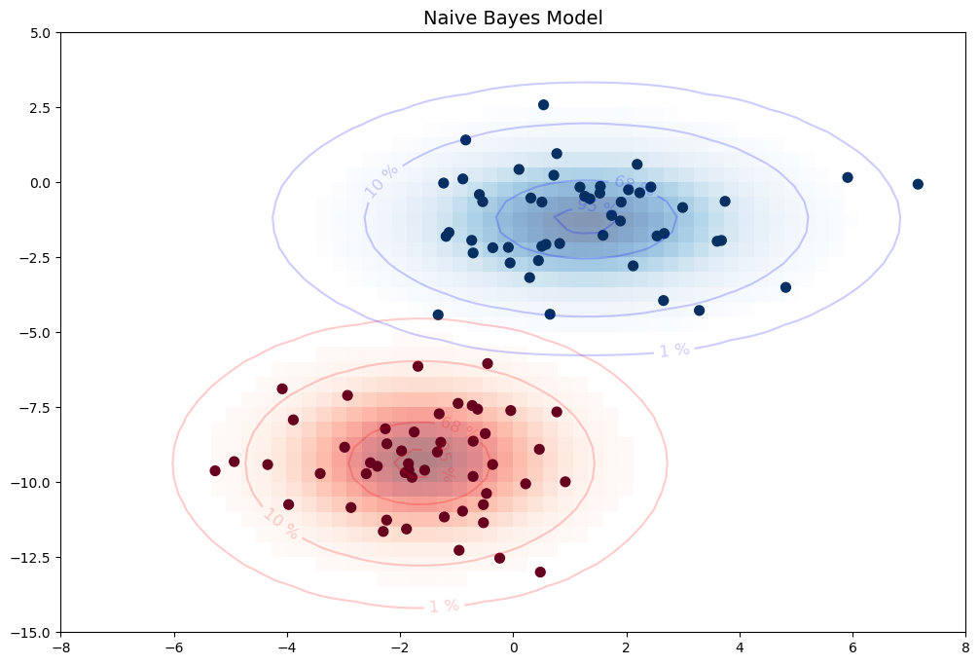
Sample Gaussian Naïve Bayes classifier for two labels
Contours correspond to different variances from the center

Slide 13
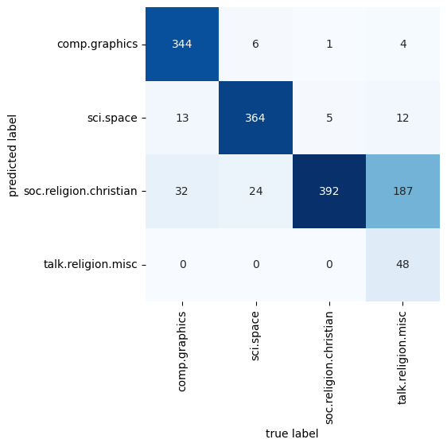
Sample Confusion Matrix for a Multinomial Naïve Bayes classifier
MultinomialNB does a good job in distinguishing text (once they’re vectorized)

Slide 14
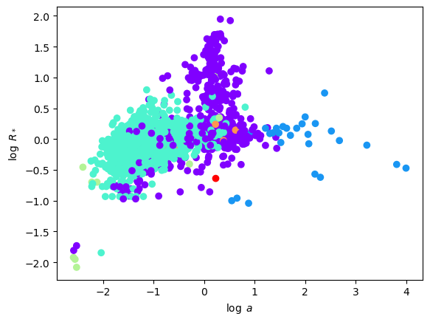
Innovation: predicting the detection type of an exoplanet from the semi-major axis of its orbit around the host star and its host star’s radius
Warning: highly unbalanced data!
(Data downloaded from exoplanet.eu/catalog)

Slide 15
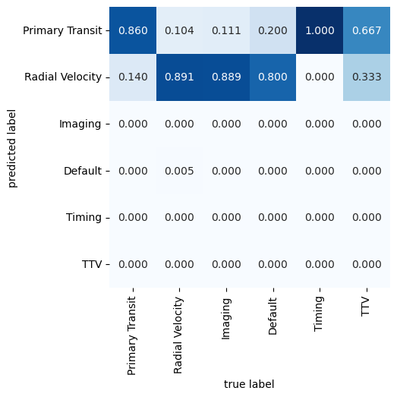
Using ComplementNB, we get this confusion matrix (which got confused)
Even with ComplementNB’s ability to adapt to unbalanced data, the model still predicts only three of the six present labels

Slide 16
Tutorial 3: Exoplanet exploration using ML
Forked and cloned Nagesh Singh Chauhan’s GitHub repo, read through his blog post, and downloaded the datasets from Kaggle
To summarize his notebook, exoplanet-exploration-using-ml.ipynb:
EDA shows an unbalanced dataset (for training set, 5050 vs 37 objects labeled “not an exoplanet” vs exoplanet), features aren’t clear (Kaggle describes them as “fluxes over time” → time series data?)
Preprocessing for him includes splitting the x- and y-components of both sets, normalizing, applying Gaussian filter and then scaling the x-components
Then, he applies several models (Decision Tree, Logistic Regression, and K-Nearest Neighbors) and evaluated them using the accuracy score, classification report (which includes recall score), confusion matrix, and receiver operating characteristic (ROC) – all of which did pretty bad for the unbalanced set
Applied an oversampling method called Synthetic Minority Oversampling Technique (SMOTE) on the training set alone AND THEN split this set onto a new training and test set – there he found more success!

Slide 17
Tutorial 3: Exoplanet exploration using ML
Innovations:
Replotted several of the EDA plots
Combined the training and test sets, split this combined dataset properly (stratified according to the ratio of labels), and then applied the normalization, Gaussian filter, and StandardScaler.
From this preprocessed set, applied the models to the unbalanced set (got a better recall score for logistic regression)
Balanced the classes on the training set using SMOTEENN, a combined SMOTE (for oversampling) and Edited Nearest Neighbors (for undersampling) technique provided by imblearn
Fitted the models again to this new training set and got better recalls for all three models

Slide 18
Tutorial 4: Exoplanet exploration using ANN
Also from Nagesh Singh Chauhan’s GitHub repo, using the same datasets, adapting the python script onto a Jupyter notebook
To summarize his python script, “exoplanet-ANN.py”:
Data went through the same preprocessing, except now he reduced the memory by changing the data types and applied PCA
Principal Components Analysis (PCA) is a way of reducing the number of features needed whilst keeping a fraction of the variance intact. In his dataset of 3198 x-components (features), he only got 37 components which he believed to contain 99% of the variance
After incorrectly reducing the number of columns, he built an ANN using the KerasClassifier instance, which allows for smooth integration with sklearn. The neural network is composed of:
One input layer with 4 neurons, ReLU activation, and uniform kernel initializer
One hidden layer with 4 neurons, ReLU activation, and uniform kernel initializer, and
One output layer with 1 neuron, sigmoid activation, and uniform kernel initializer
Evaluated his model using cross-validation score, with mean 0.77 and variance 0.26

Slide 19
Tutorial 4: Exoplanet exploration using ANN
Innovations:
Reapplied the PCA properly: first analyzed how many features are needed to keep 99% of the variance (53 features), then refitted the training set with this number of features
Resampled the downsized dataset by using SMOTEENN (like in Tutorial 3)
Searched for optimal hyperparameters using skl.model_selection.GridSearchCV, which ran for 35 minutes while running through 2 optimizers x 3 kernel initializers x 3 epochs x 3 batch sizes
Applied the optimal set of hyperparameters to get a cross-validation score of mean 0.97 and variance 0.03
Compared the performance with a simple MLPClassifier model with hidden layer size (4,2), got a cross-validation score of mean 0.94 and variance 0.01

Slide 20
Tutorial Feature PCA
Ran through Jake Vanderplas’s tutorial on PCA
To summarize his notebook:
PCA is a projection technique that allows for dimensionality reduction and noise filtering: the projection happens by getting the eigenvectors of the covariance matrix of the dataset and arranging them in descending order of eigenvalues
To use PCA for dimensionality reduction, you can get a certain number of principal components that would reconstruct a fraction of the total variance by getting the eigenvectors with the largest eigenvalues
To use PCA for noise filtering, set the variance threshold of the eigenvectors to be greater than that of the variance of the noise. By getting this number of eigenvectors, you can cancel the effect of the noise
Applications include reconstructing images from noisy data and reconstructing faces from only a certain number of PCs

Slide 21
Tutorial Feature PCA
Innovations:
Reanalyzed Nagesh Chauhan’s dataset using the correct PCA method: got 53 components instead of his 37
Applied another dimensionality reduction technique called “Local Linear Embedding”, which is a manifold learning technique that can be useful for classification of light curves by projecting high-dimensional data onto a nonlinear sequence
Compared the performance of a KNN model using these two datasets and found out that the PCA-reduced dataset has a better KNN model performance than the LLE-reduced dataset

Slide 22
Tutorial 5: Parallel processing
Ran through the colab notebook on python multiprocessing
To summarize the notebook:
Created a pool using `pathos.multiprocessing.ProcessPool`, i.e. a group of processes where tasks will be sent
Explored several functions under the ProcessPool such as map, imap, uimap, and amap
Applied the uimap (non-blocking, unordered pool) by creating a function that downloads poems and produces its sentiment (i.e. the tone of the piece).
Tested the pool’s capabilities by downloading and analyzing several poems all at once, which took only 5 seconds. Compared this with serial processing which took 7 seconds.

Slide 23
Tutorial 5: Parallel processing
Innovations:
Used `dask-ML` which is a package that contains similar functions to sklearn
Optimized the GridSearchCV from Tutorial 4, which finds the best hyperparameter combination for 2 optimizers x 3 kernel initializers x 3 epochs x 3 batch sizes via a grid search (using all combinations and running the NN)
Using `sklearn.model_selection.GridSearchCV`, code originally ran for 35 minutes. Now it ran for only 19 minutes using `dask_ml.model_selection.GridSearchCV`!

